Slide 1
Moore, Mealy Conversions

Slide 2
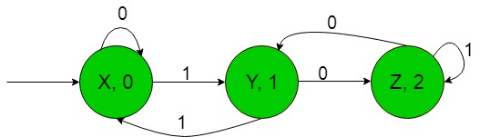
Above Moore machine takes the binary number {0, 1} as input and produce residue modulo ‘3’ as output i.e, when the equivalent decimal number of binary input over {0, 1} is divided by 3 then it gives output as it’s remainder.

Slide 3
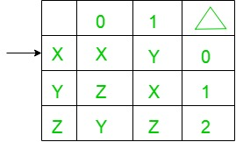
Moore machine to the Mealy machine
Step-1: Formation of State Transition Table of the above Moore machine-
Step-2: Formation of Transition Table for Mealy machine from above Transition Table of Moore machine-
Below transition table is going to be formed with the help of the above table and its entries just by using the corresponding output of the states of the first column and placing them in the second and third column accordingly.

Slide 4
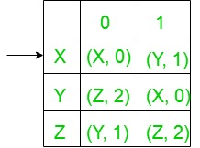
In the above table, the states in the first column like ‘X’ on getting ‘0’ as the input it goes to a state ‘X’ and gives ‘0’ as the output and on getting ‘1’ as the input it goes to the state ‘Y’ and gives ‘1’ as the output and so on for the remaining states in the first column. In the table, An arrow (→) indicates the initial state.

Slide 5
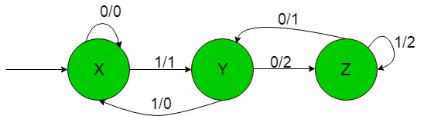
Above Mealy machine takes the binary number {0, 1} as input and produce residue modulo ‘3’ as output i.e, when the equivalent decimal number of binary input over {0, 1} is divided by 3 then it gives output as it’s remainder.

Slide 6
Conversion from Moore machine to Mealy machine
For understanding the conversion of Moore machine to Mealy machine, let us take an example:
Suppose the Moore machine transition table is:
Present State | Next State |  | Output
 | a | b
→p | s | q | 0
q | q | r | 1
r | r | s | 0
s | s | p | 0

Slide 7
Conversion from Moore machine to Mealy machine
First of all take the Mealy machine transition table format, and copy all the Moore machine transition table states into Mealy machine transition table.
Present State | Next State
 | a | b
→p | s | q
q | q | r
r | r | s
s | s | p

Slide 8
Conversion from Moore m/c to Mealy m/c
Now in the Moore machine, the output of state p is 0. So make the output of p in the Mealy machine next state column of the above table is 0. Same process is repeated for q, r and s.
Moore Machine
Mealy Machine
Present State | Next State |  | Output
 | a | b
→p | s | q | 0
q | q | r | 1
r | r | s | 0
s | s | p | 0
Present State | Next State
 | a | b
→p | s, 0 | q, 1
q | q, 1 | r, 0
r | r, 0 | s, 0
s | s, 0 | p, 0

Slide 9
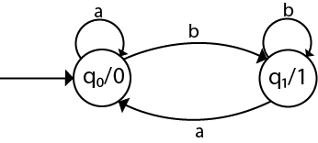
Question 1

Slide 10
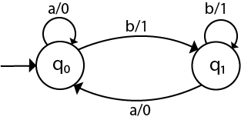
Solution-1

Slide 11
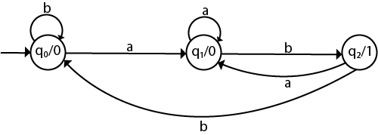
Question-2

Slide 12
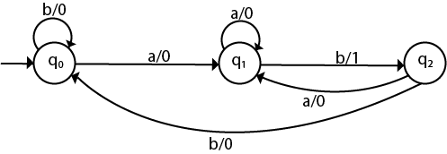
Solution-2

Slide 13
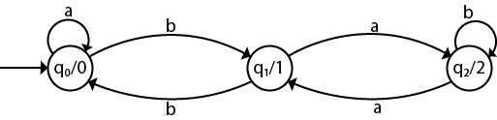
Question-3

Slide 14
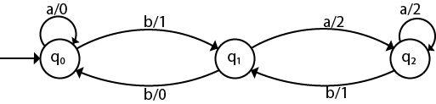
Solution-3

Slide 15
Mealy machine to the Moore machine
The following steps are used for converting Mealy machine to the Moore machine:
Step 1: For each state(Qi), calculate the number of different outputs that are available in the transition table of the Mealy machine.
Step 2: Copy state Qi, if all the outputs of Qi are the same. Break qi into n states as Qin, if it has n distinct outputs where n = 0, 1, 2....
Step 3: If the output of initial state is 0, insert a new initial state at the starting which gives 1 output.

Slide 16
Conversion from Mealy machine to Moore machine
Convert given Mealy machine to Moore machine.
Mealy Machine
Moore Machine
Present State | Next State
 | a | b
→q0 | q3, 0 | q1, 1
q1 | q0, 1 | q3, 0
q2 | q2, 1 | q2, 0
q3 | q1, 0 | q0, 1
Present State | Next State |  | Output
 | a | b
→q0 | q3 | q11 | 1
q10 | q0 | q3 | 0
q11 | q0 | q3 | 1
q20 | q21 | q20 | 0
q21 | q21 | q20 | 1
q3 | q10 | q0 | 0
Split q1 into q10 and q11
and
Split q2 into q20 and q21

Slide 17
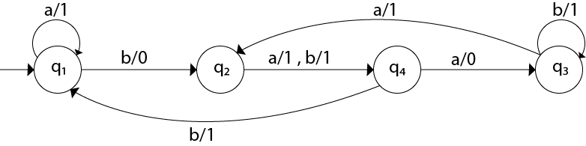
Question-1

Slide 18
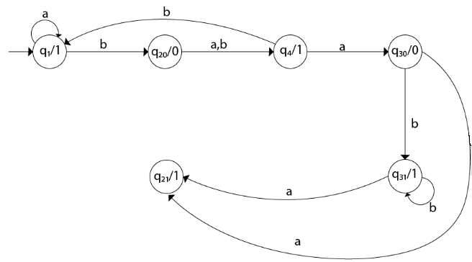
Solution-1

Slide 19
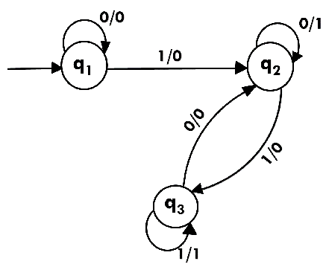
Question-2

Slide 20
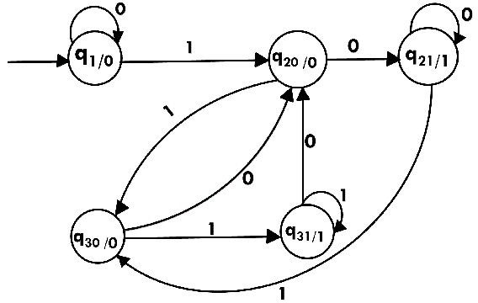
Solution-2

